Slide 1
Lecture 3
Class Design & Encapsulation
In Object-Oriented Programming

Slide 2
Previously on PR2…
In the previous lecture, you learned about:
  Why use OOP?
  Object, attributes and behavior
  Class
  Instances in Java
  Class as a 3-compartment box
  The dot (.) operator
  Constructors
  Primitives vs References
  Static vs non-static

Slide 3
Instance Variables
An instance variable has a name (or identifier) and a type; and holds a value of that particular
  Naming Convention: A variable name shall be a noun or noun phrase. The first word is in lowercase and the rest of the words are initial-capitalized (camel-case).
[AccessControlModifier] type variableName [= initialValue];
[AccessControlModifier] type variableName-1 [= initialValue-1] [, type variableName-2 [= initialValue-2]] ... ;
E.g.
private double radius;
public int length = 2, width = 1;

Slide 4
Instance Methods
A method:
  receives arguments from the caller,
  performs the operations defined in the method body, and
  returns a piece of result (or void) to the caller.
The syntax for method declaration in Java is as follows:
[AccessControlModifier] returnType methodName ([parameterList]) {
// method body or implementation
......
}

Slide 5
Instance Methods
Method Naming Convention:
  A method name shall be a verb, or a verb phrase made up of several words. The first word is in lowercase and the rest of the words are initial-capitalized (camel-case).
  For example: getArea(), setRadius()…
// return the area of this Circle instance
public double getArea() {
return radius * radius * Math.PI;
}
// return type is void => does not contain a return value
public void setWidth(double width) {
this.width = width;
}

Slide 6
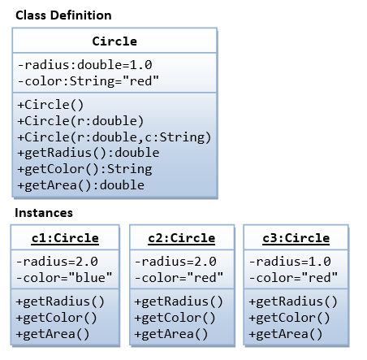
OOP Example: Circle class

Slide 7
Source code: Circle.java
public class Circle {
// instance variables
private double radius;
private String color;
public Circle() { // default constructor
radius = 1.0;
color = "red";
}
public Circle(double r, String c) { // another constructor
radius = r;
color = c;
}
public double getRadius() { return radius; }
public String getColor() { return color; }
public double getArea() {
return radius * radius * Math.PI;
}
}

Slide 8
Example test source code: TestCircle.java
public class TestCircle {
public static void main(String[] args) {
// Create Circle instances
// Use default constructor
Circle c1 = new Circle();
// Use the other constructor
Circle c2 = new Circle(2.0, "blue");
// invoke instance methods
System.out.println("The radius is: " + c2.getRadius());
System.out.println("The color is: " + c2.getColor());
System.out.printf("The area is: %.2f%n", c2.getArea());
}
}

Slide 9
Method Overloading (Revisit)
Method overloading allows a method name to have multiple implementations (version).
These implementations must be distinguishable by their parameter list.
Parameters can differ in number, type, or order.

Slide 10
Method Overloading
public class MyClass {
void method() {}
void method(int x) {}
void method(float x) {}
void method(int x, double y) {}
}
In class MyClass, there are 4 methods with the same name but different parameters

Slide 11
Method Overloading
Example: The method average() has 3 versions, with different parameter lists. The caller can invoke the chosen version by supplying the matching arguments.
public class MethodOverloadingTest {
public static int average(int n1, int n2) { // version 1
System.out.println("Run version 1");
return (n1 + n2) / 2;
}
public static double average(double n1, double n2) {
// version 2
System.out.println("Run version 2");
return (n1 + n2) / 2;
}
public static int average(int n1, int n2, int n3) { // version 3
System.out.println("Run version 3");
return (n1 + n2 + n3) / 3;
}
}

Slide 12
Method Overloading
public static void main(String[] args) {
System.out.println(average(1, 2));
// run version 1
// 1
System.out.println(average(1.0, 2.0));
// run version 2
// 1.5
System.out.println(average(1, 2, 3));
// run version 3
// 2
System.out.println(average(1.0, 2));
// run version 2 (int 2 implicitly casted to double 2.0)
// 1.5
// average(1, 2, 3, 4);
// compilation error: no suitable method found
// for average(int,int,int,int)
}

Slide 13
Constructors (Revisit)
A constructor is a special method used to create objects
Characteristics of a constructor:
  It has the same name as the class
  It has no return type in its method heading. It implicitly returns void
  It does not return a value
  It can only be invoked via the new operator
  Constructors are not inherited (explained later)

Slide 14
Example of constructor
  public class Circle {
  private double radius;
  private String color;
  public Circle() {
  radius = 1.0;
  color = "red";
  }
  public Circle(double r) {
  radius = r;
  color = "red";
  }
  public Circle(double r, String c) {
  radius = r;
  color = c;
  }
  }
Class
  Circle c1 = new Circle();
  // use 1st constructor
  Circle c2 = new Circle(2.0);
  // use 2nd constructor
  Circle c3 = new Circle(3.0, "red"); // use 3rd constructor
Instances

Slide 15
Contructor Overloading
Constructor, like an ordinary method, can also be overloaded.
  The Circle class has three overloaded versions of constructors differentiated by their parameter list, as followed:
Circle() // the default constructor
Circle(double r)
Circle(double r, String c)

Slide 16
Overloading
Depending on the actual argument list used when invoking the method, the matching constructor will be invoked.
If your argument list does not match any one of the methods, you will get a compilation error.
  Note: C language does not support method overloading. You need to use different method names for each of the variations. C++, Java, C# support method overloading.

Slide 17
this keyword
this is used to refer to this instance inside a class definition.
this is used within a class to reference the members of the class (fields and methods)
Use this.field to differentiate between the class’ field and local variables or method parameters

Slide 18
this keyword
public class Circle {
double radius;
public Circle(double radius)
this.radius = radius;
// "radius = radius" does not make sense!
// "this.radius" refers to an instance's member
// "radius" resolved to the method's parameter
}
...
}
Java offers a keyword called this to address such naming conflicts.
Using this.radius specifies the member variable, whereas simply radius refers to the method's argument.

Slide 19
Package
Package is used to divide classes and interfaces into different groups.
This job is similar to putting files in folders on the hard disk
The following example creates class MyClass in package lect3;
package lect3;
public class MyClass {
}

Slide 20
Package
Similar to hard disk files & folders structure, we can create sub-packages inside packages
In Java there are many packages divided by function
  java.util: contains utility classes
  java.io: contains data input/output classes
  java.lang: contains commonly used classes…

Slide 21
Importing package
The import statement is used to indicate that the class has been defined in a package
Classes in the java.lang package and classes defined in the same package as the using class will be imported by default
package lect.lect4;
import lect.lect3.MyClass;
import java.util.Scanner;
public class HelloWorld {
public static void main(String[] args) {
MyClass obj = new MyClass();
Scanner sc = new Scanner(System.in);
… }}

Slide 22
The Access Control Modifiers
An access control modifier can be used to control the visibility of a class, or a member variable or a member method within a class
In java there are 4 different characteristics:
  private: allowed to be used only internally within the class
  public: completely public
  {default}:
    It is public for classes accessing the same package
    Is private from other export packages of the classes
  protected: similar to {default} but allowed to design even if the subclass and package are different

Slide 23
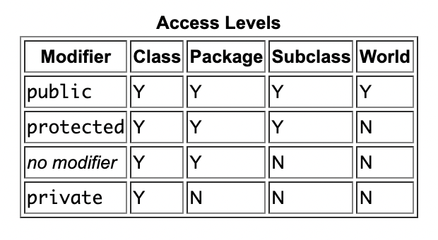
The Access Control Modifiers
The level increases gradually in the direction of the arrow

Slide 24
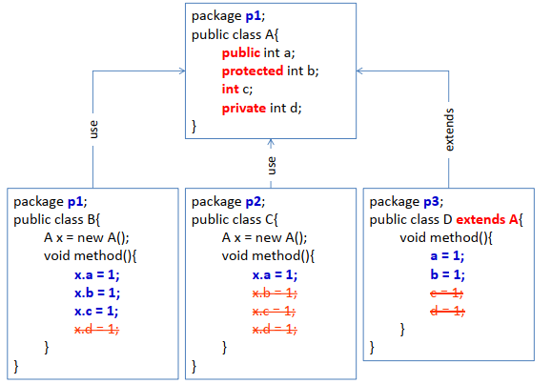
The Access Control Modifiers

Slide 25
Non-Encapsulation
Suppose you define the Student class and declare name and score as follows
  When using, users can assign data to fields arbitrarily
  What if valid scores are only from 0 to 10
public class Student{
  public String name;
  public double score;
}
public class MyClass{
  public static void main(String[] args) {
    Student s = new Student();
    s.name = "Emma Watson";
    s.score = 20.5;
}}

Slide 26
Information Hiding
Definition: A design principle that restricts access to an object’s internal details.
Purposes:
  Protect object integrity
  Reduce system complexity
  Prevent unwanted changes
  Allow internal changes without affecting external codes
How to achieve information hiding in Java?
  Use access modifiers to control visibility

Slide 27

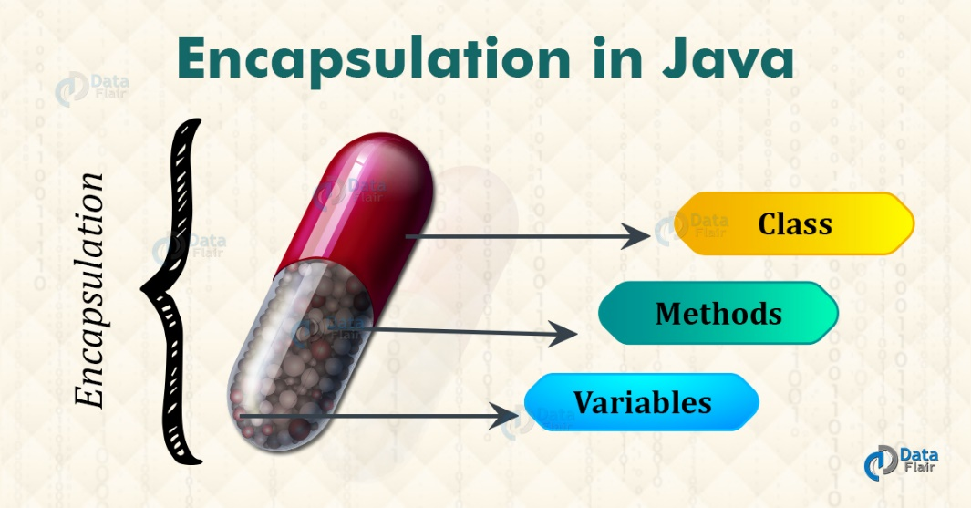
Encapsulation
Encapsulation combines data and related operations into a single unit and restricts access to the object’s internal state.
  Hidden data fields (use methods to retrieve data)
  Ensures data integrity
  Allows validation before modifying data
  Supports modular, reusable design

Slide 28
Encapsulation
To hide information, use private for data fields
  private double score;
Add getter and setter methods to read and write private fields
public void setScore(double score) {
  this.score = score;
}
public String getScore(){
  return this.score;
}

Slide 29
Encapsulation
public class Student {
  private String name;
  private double score;
  public void setName(String name) {
  this.name = name;
  }
  public String getName() {
  return this.name;
  }
  public void setScore(double score) {
  if (score < 0 || score > 10) {
  System.out.println("Score invalid");
  } else {
  this.score = score;
  }
  }
  public double getScore() {
  return this.score;
  }
}
Just add code to the setScore() method to handle invalid data

Slide 30
Encapsulation
public class MyClass {
  public static void main(String[] args) {
    Student sv = new Student();
    sv.setName("Emma Watson");
    sv.setScore(8.5);
  }
}

Slide 31
Method toString()
  A class should contain a public toString() method
  toString() method: Provides a string description of the class instance
  Invocation: anInstanceName.toString()
  Implicit invocation: Through println() or the + operator
  println(anInstance): Implicitly triggers the toString() method for that instance

Slide 32
Method toString()
// return a String description of this instance
public String toString() {
return "Name: " + name + ", score: " + score;
}
public class MyClass{
  public static void main(String[] args){
    Student sv = new Student();
    sv.setName("Emma Watson");
    sv.setScore(8.5);
    System.out.println(sv.toString());
    // Name: Emma Watson, score: 8.5
  }
}

Slide 33
Constants in Java
A constant is a variable declared with the final modifier.
  can be assigned only once
  must be initialized when declared
  its value cannot be modified after initialization
Example:
public class JavaConstants {
public final double X_REFERENCE = 1.234;
private final int MAX_ID = 9999;
public void someMethod() {
this.MAX_ID = 10000;
// Error: cannot assign value to final variable MAX_ID
}
}

Slide 34
Notes on final
Naming convention:
  Constant names are nouns or noun phrases.
  Uppercase words separated by underscores.
  Examples: X_REFERENCE, MAX_INTEGER…
Some behaviors:
  A final primitive variable cannot be reassigned a new value.
  A final reference variable cannot take a new object, but the object’s internal state may still change.

Slide 35
Lecture summary
Instance Variables
Instance Methods
Method Overloading
The Access Control Modifiers
Encapsulation
Method toString()
Java Constants

